Slide 2
3 things I learned in core
Ways of dealing with sensory overload
No, I can’t think of them off the top of my head
More information on how your behaviour can affect being hired and promotions
Some other stuff

Slide 3
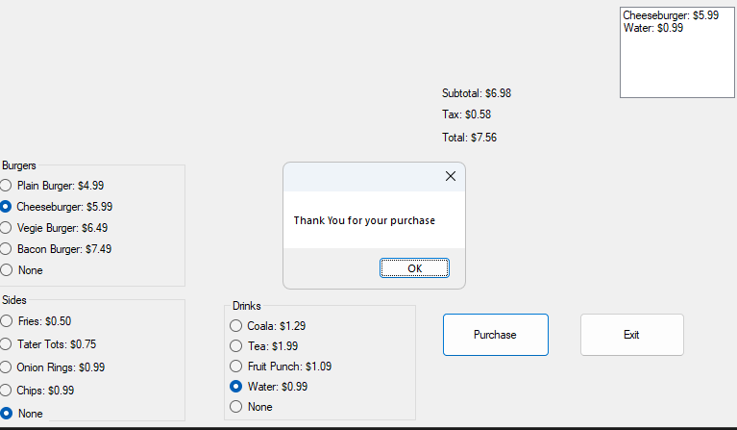
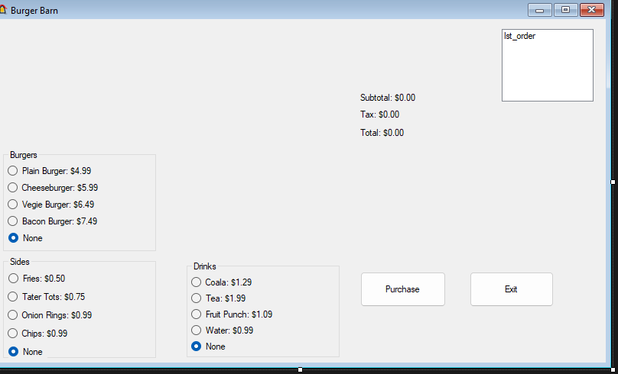
3 Things I leaned in Tech
How to make a close button which requires a confirmation period, that way a misclick won’t make it just
My own invention
How to make multiple buttons be bonded to a single event
How to simplify certain parts
And designed a very effective and efficient one. Best part though?
It’s modular
Highly future proof, with plans to make it better-er
Expandable to possibly make other parts smaller (albeit making it longer)
… disappear

Slide 4
Things I learned In Elective and Club
In elective (leadership), I learned a good amount about what makes good leaders, well, good leaders. It filled in a good amount of blanks, and confirmed my intuition
In gaming club, I found out (I have always suspected, but never had a situation that it could be tested) that even if it’s a game you don’t care for, if you play it with someone who you get along with, it can be fun. Even if you probably won’t play it alone, nor with multiplayer. But, it was playing the game with them that made it fun. And, I have an example! Wanna See?
Smash Bro’s with CJ. Don’t care for it (it’s alright, but not worth buying to me), but we had a lot of fun.
Basketball (I do not like sports, don’t like playing sports, ect. But with a friend, I actually had fun!)

Slide 5
Favorite Memory
Kinda hard to choose, and worse, the one I would want to put is so detailed that I can’t do it
So, I’ll go with probably my second favorite: playing games with Husam in gaming club.

Slide 6
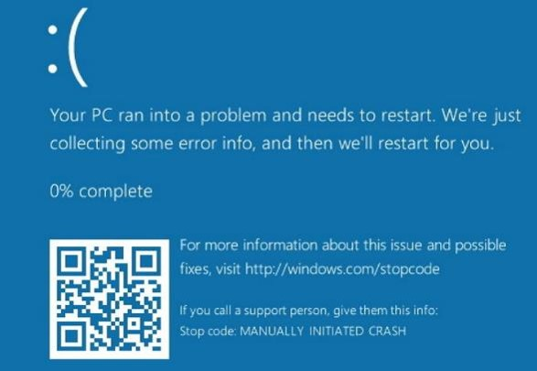

Slide 7
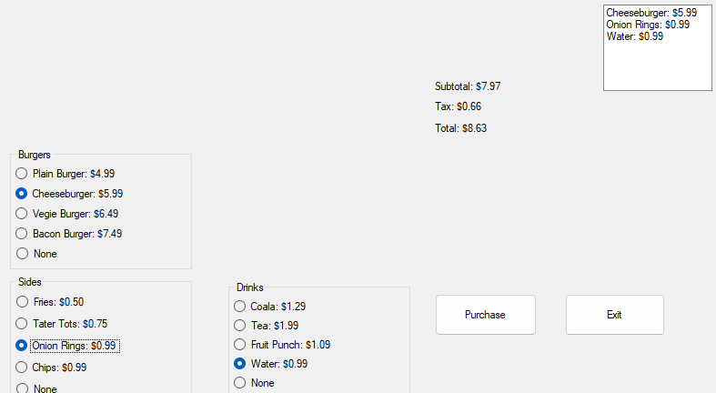
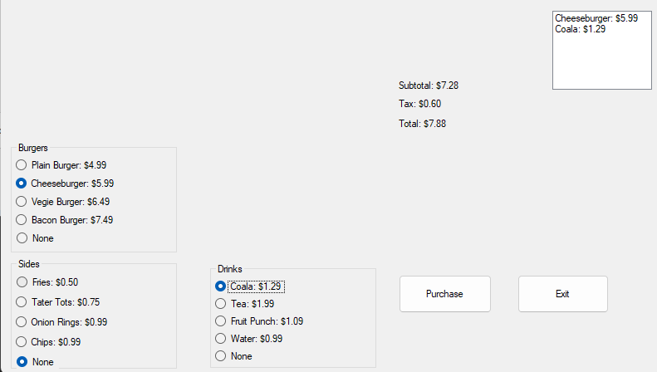
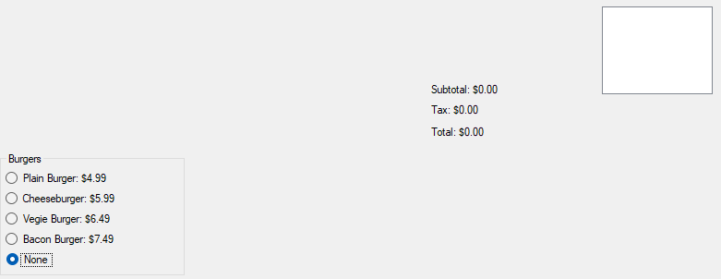
Charlie Hatch’s “Fall” Presentation- 2024
Charlie Hatch’s “Fall” Presentation- 2024
Presented to you by: Charlie Hatch
Before we start, here’s a question. how is this the fall term? I mean, Look at the weather
So, Just a second, let me fix that
There, that’s better

